Slide 1
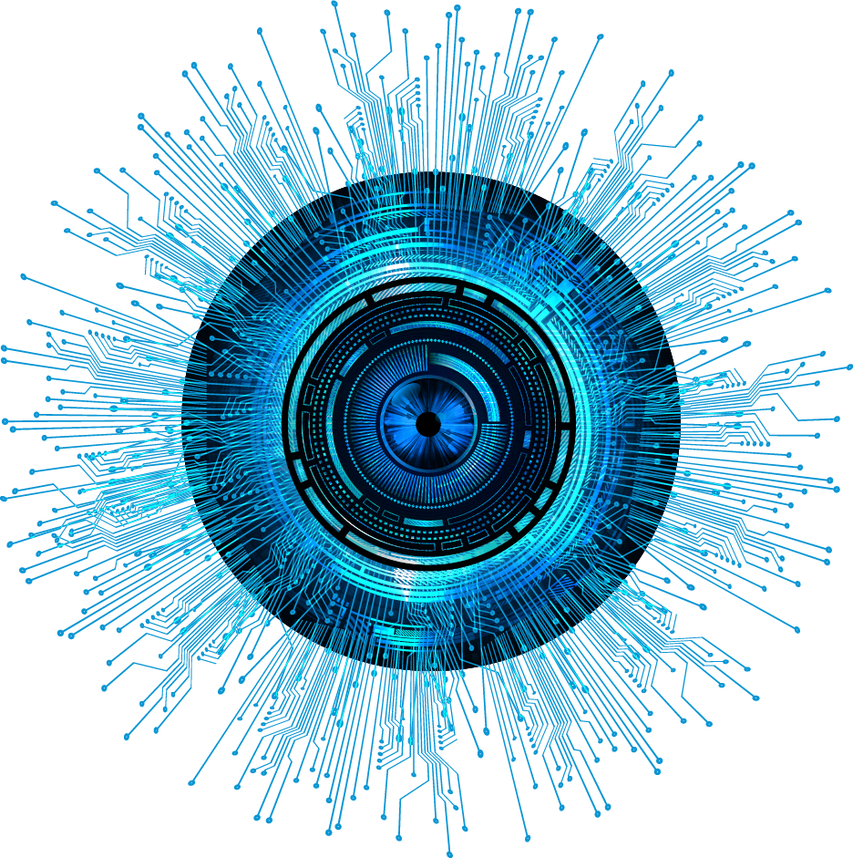
“Blue Eye”
MD. Nayim Islam
ID: 193313007
Semester: 8th
Section: A (Evening)
Project Supervisor:
Al Muktadir Munam
Lecturer
Dept. of CSE, VU

Slide 2
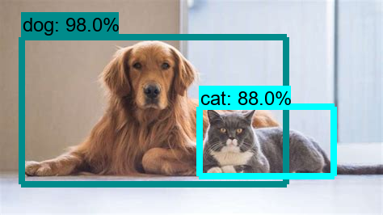
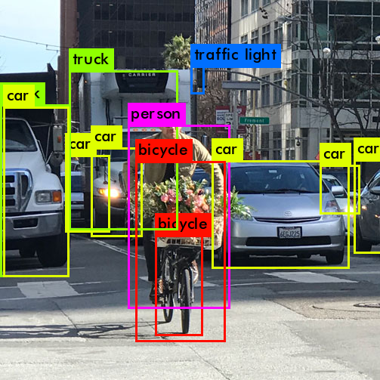
Introduction
Blue Eye software is mainly designed for people who are blind.
This software will be targeted at Android and iPhone users.
The software can be used through voice commands and touch.
The software is made dynamic.
With various options, the user will be able to use the data for his own needs through training.
This software has enough security.

Slide 3


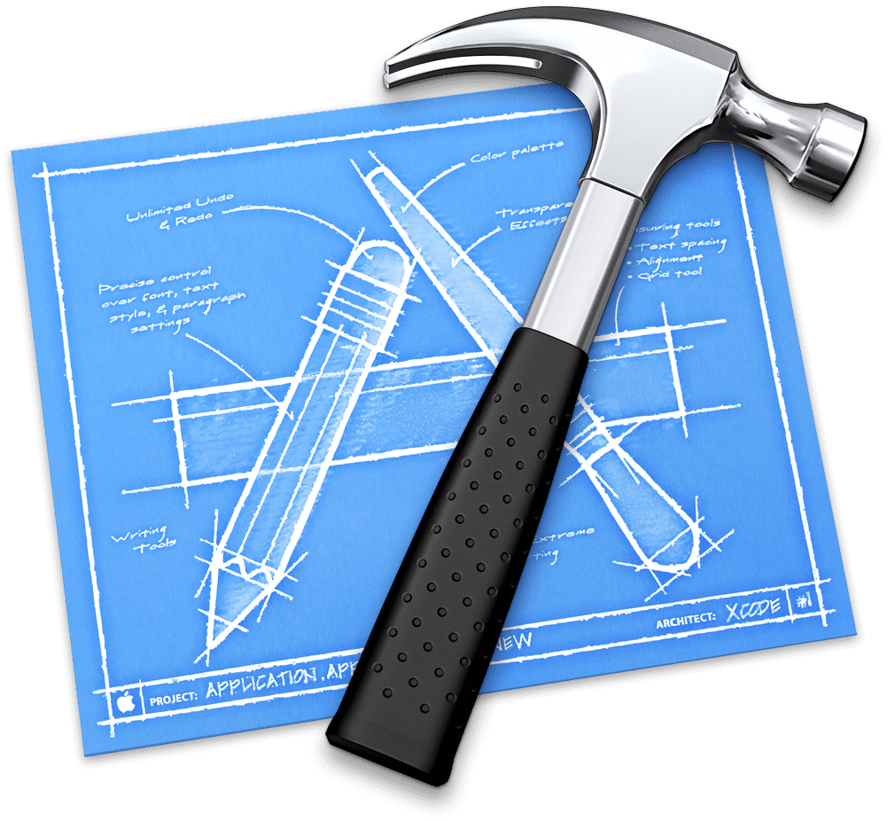



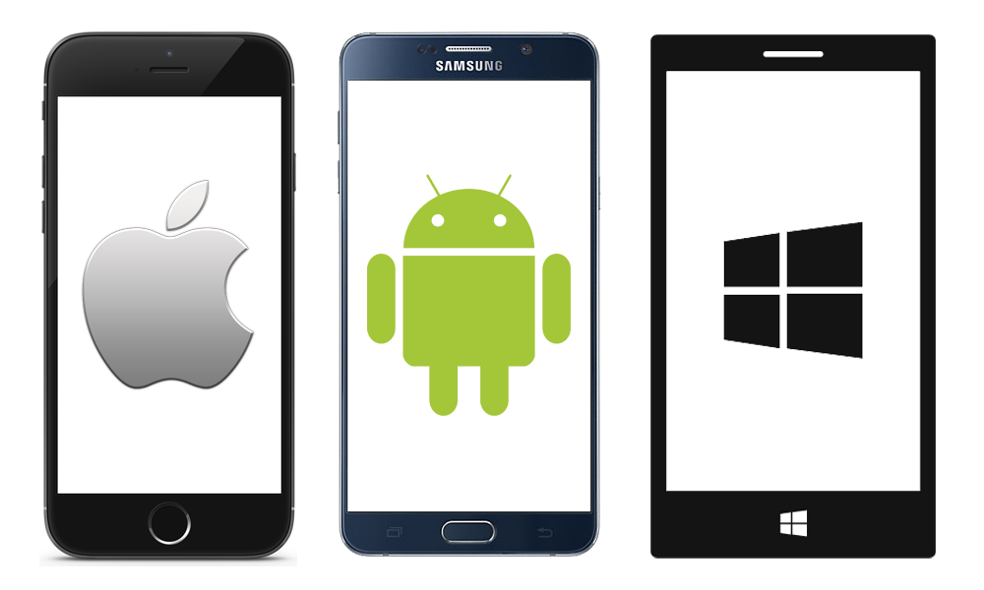


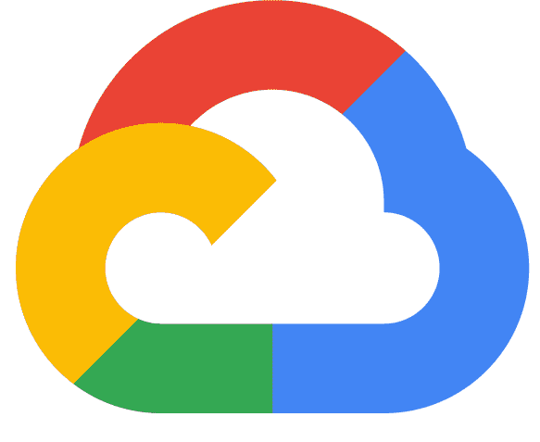


System Overview: Tools
Tools: Android Studio, VS Code, XCode.
Platform: Android, iOS, Mac, Windows, web.
Language: Dart.
Framework: Flutter
Database: Firebase, Google Cloud.
Icon Design: Adobe Illustrator CC 2021
Data Train: Teachable Machine, Dialog flow.
Emulator: Android, iOS.

Slide 4
Application Features
Object Detection by Video
Object Detection by Image
Object Detection by Pose
Voice read & speak Answer
Chatbot
All output is shown in voice & text
Users can update the Object
Users can Feedback & Rating

Slide 5
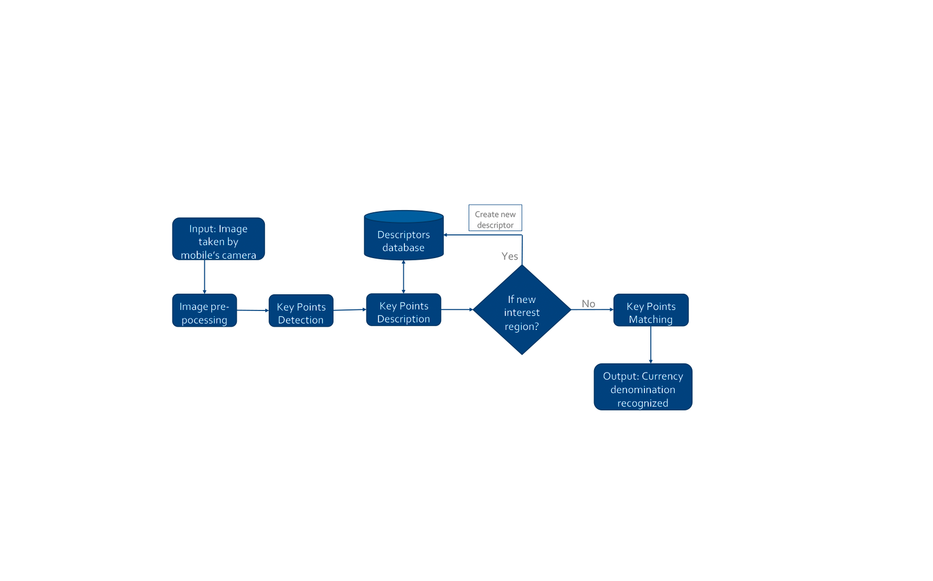
System Overview: Flowchart

Slide 6
System Diagram
Settings
Choice option
Home
Input data
Output data
Choice option
Premium
Rattings
Function
Choice option
Home
Chatbot
Feedback
Object Detection
Step 1
Step 2

Slide 7
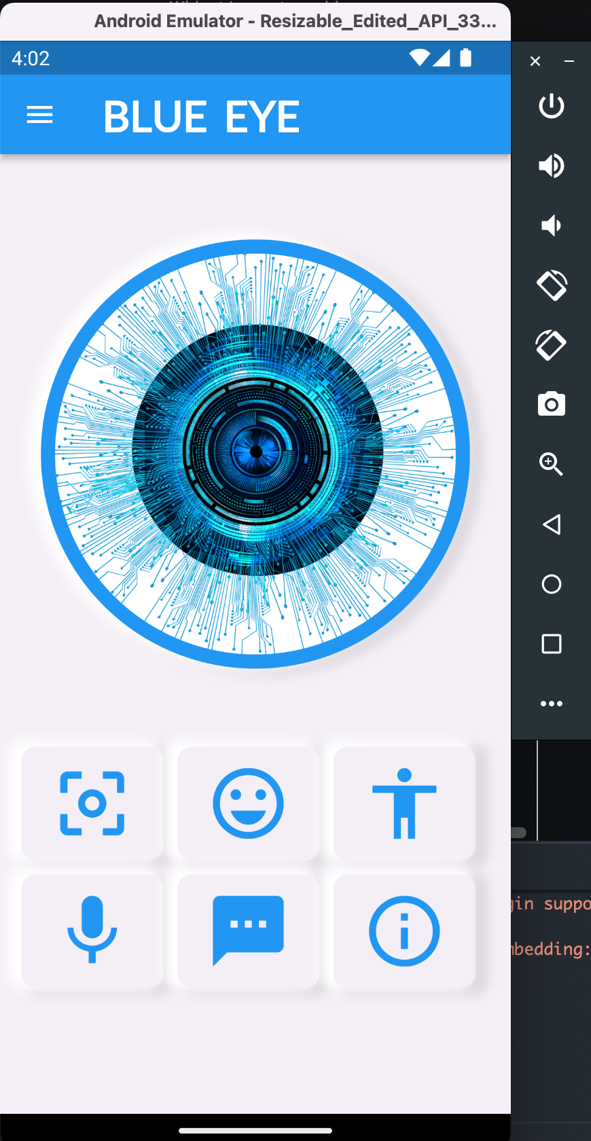
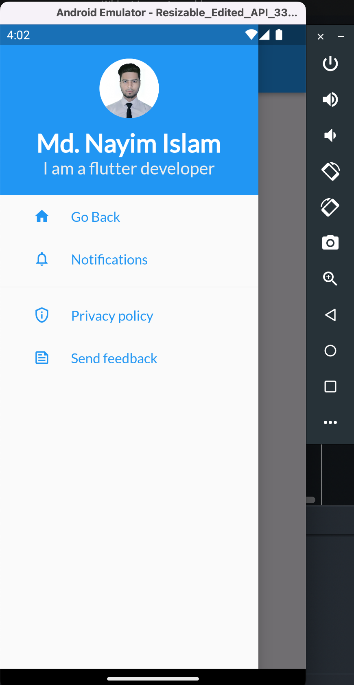
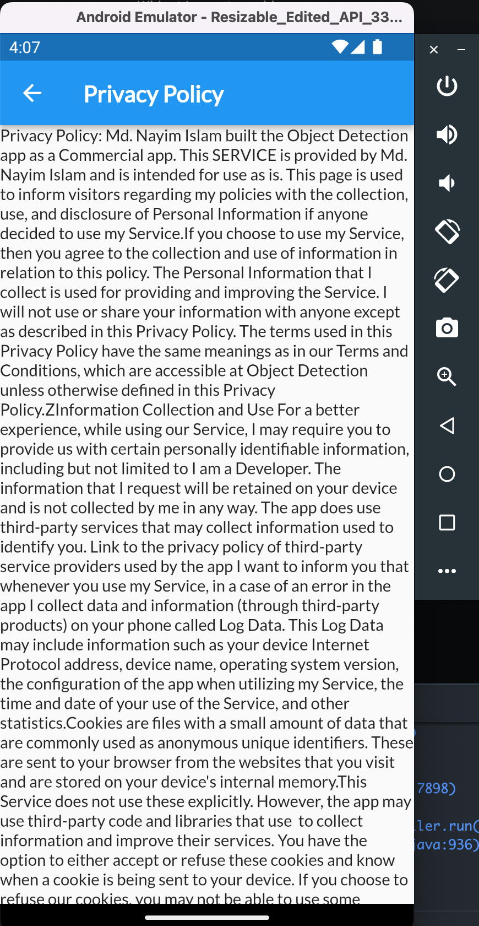
Output

Slide 8
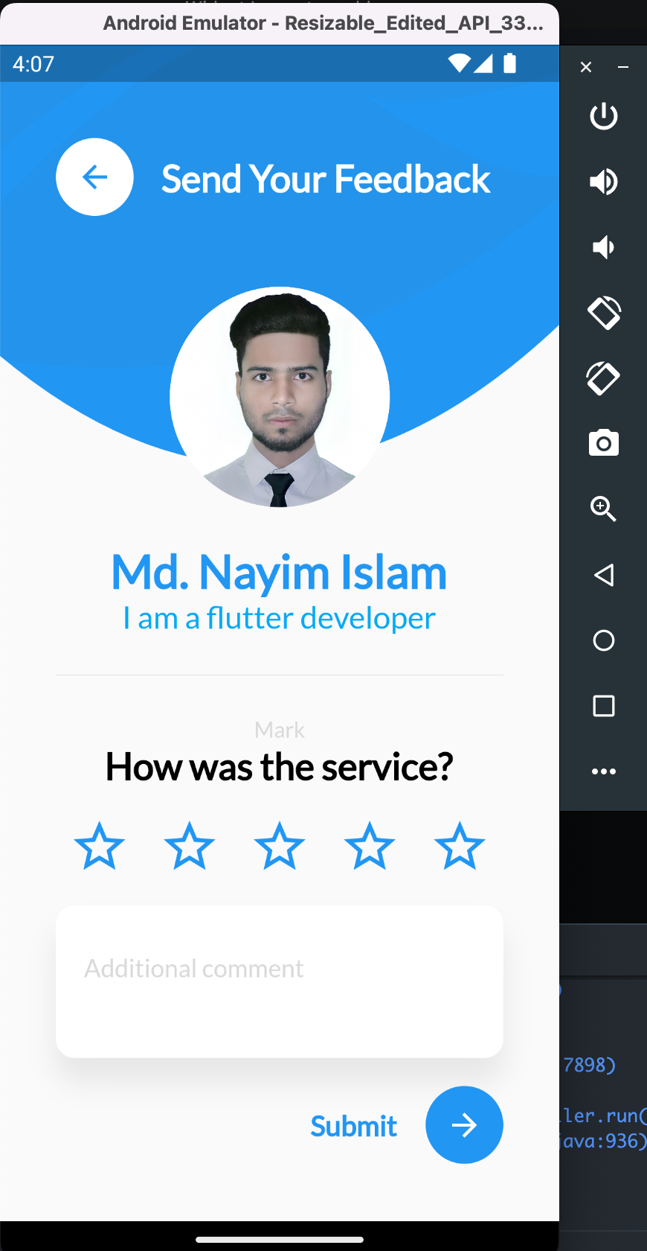
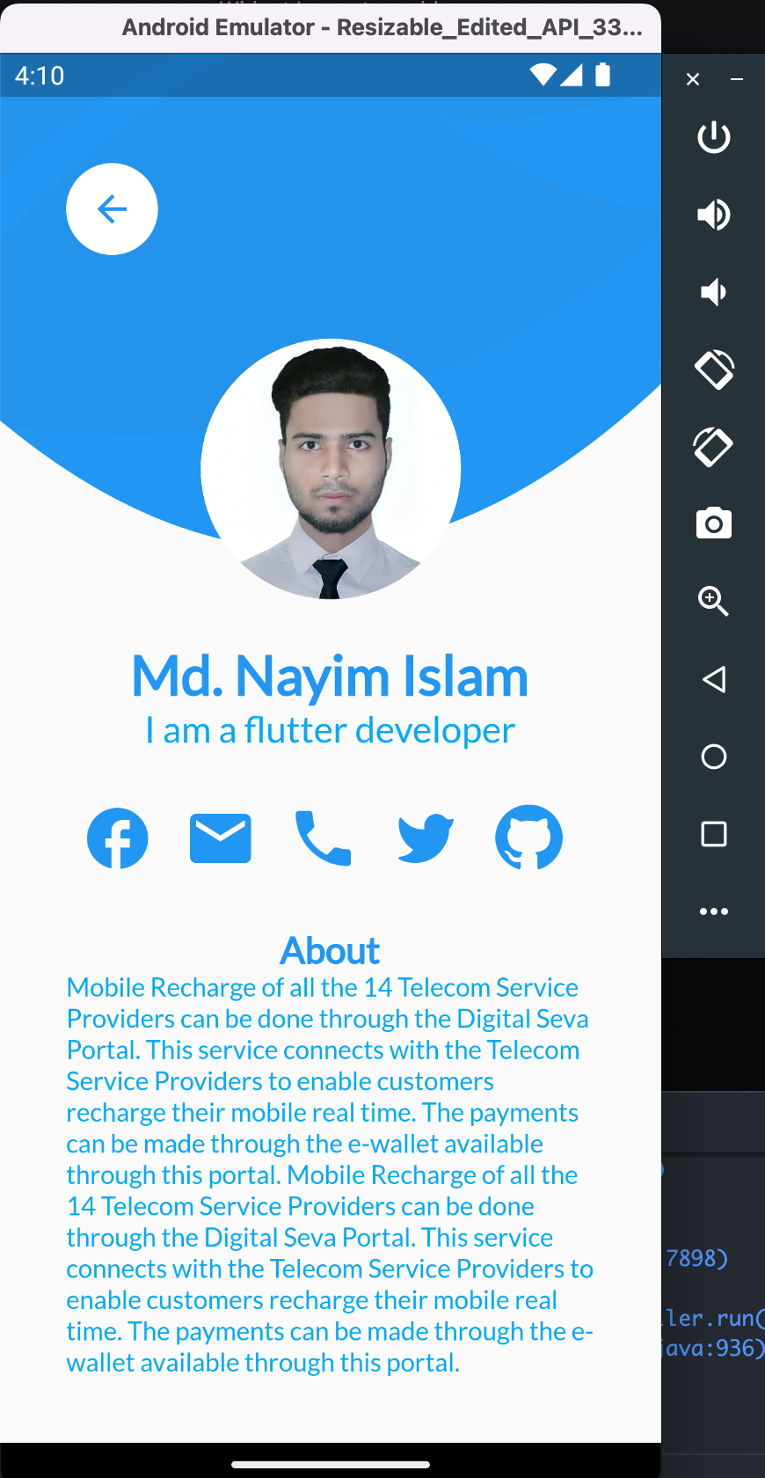
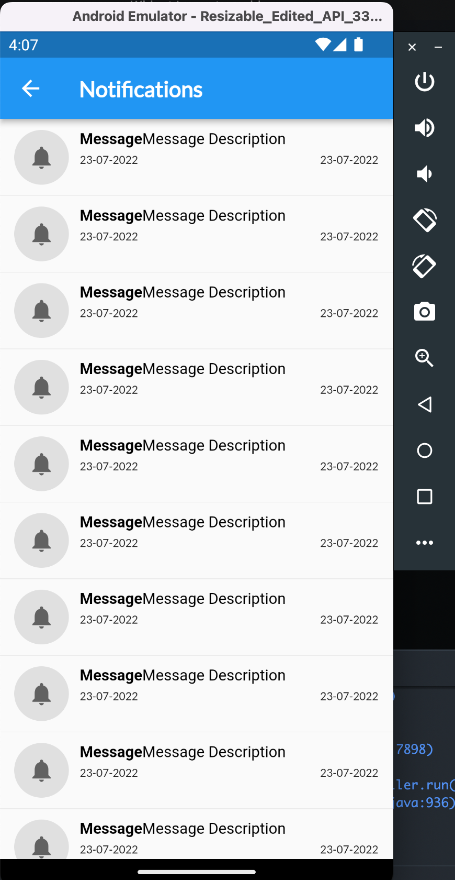
Output

Slide 9
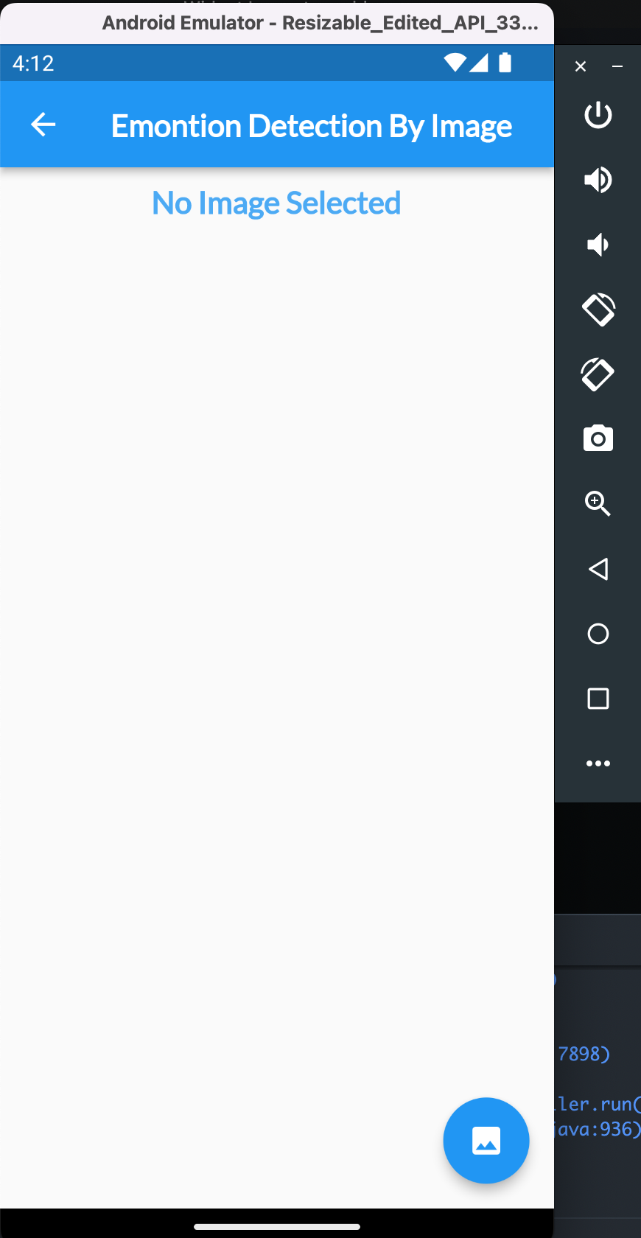
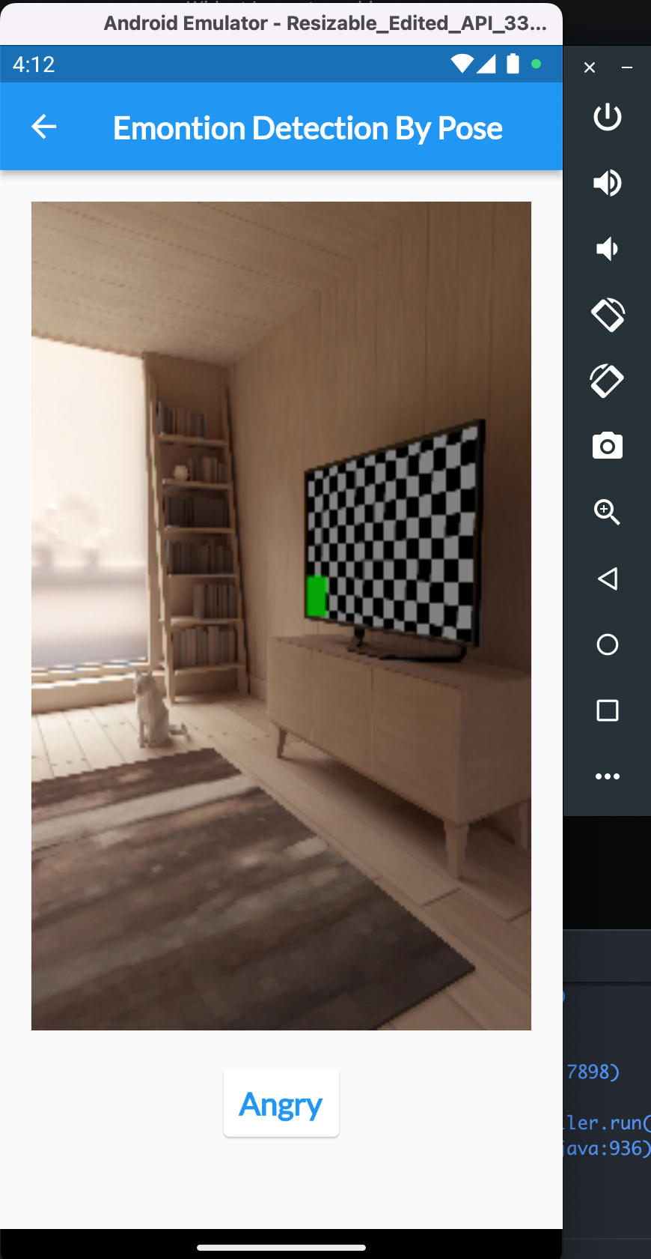
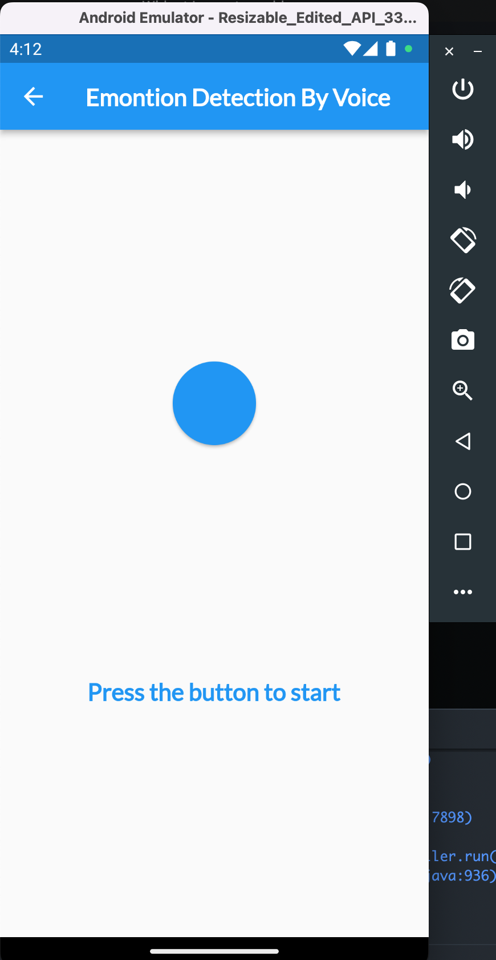
Output

Slide 10
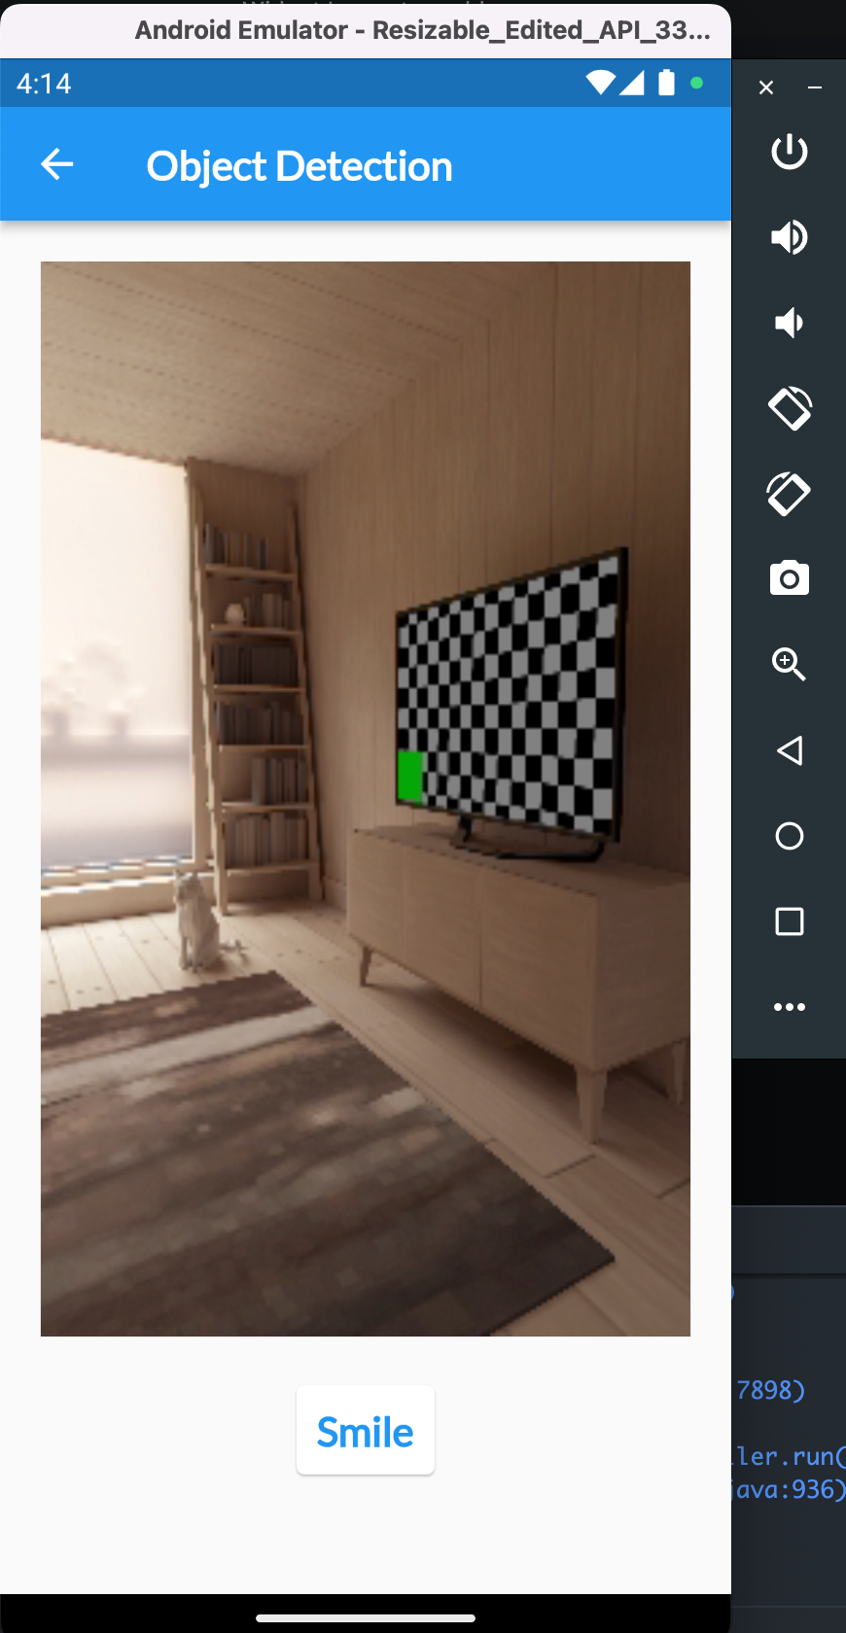
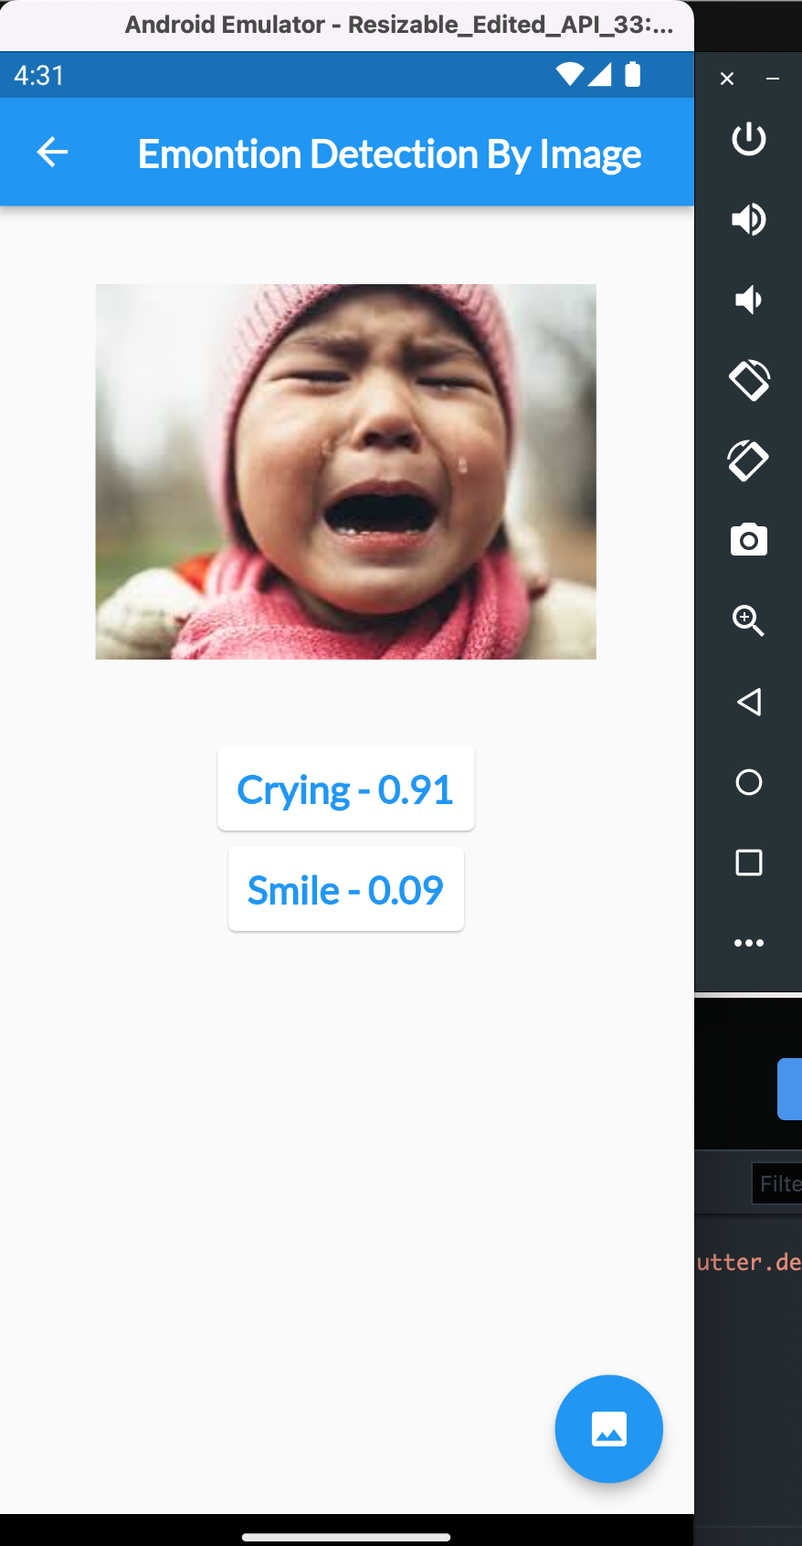
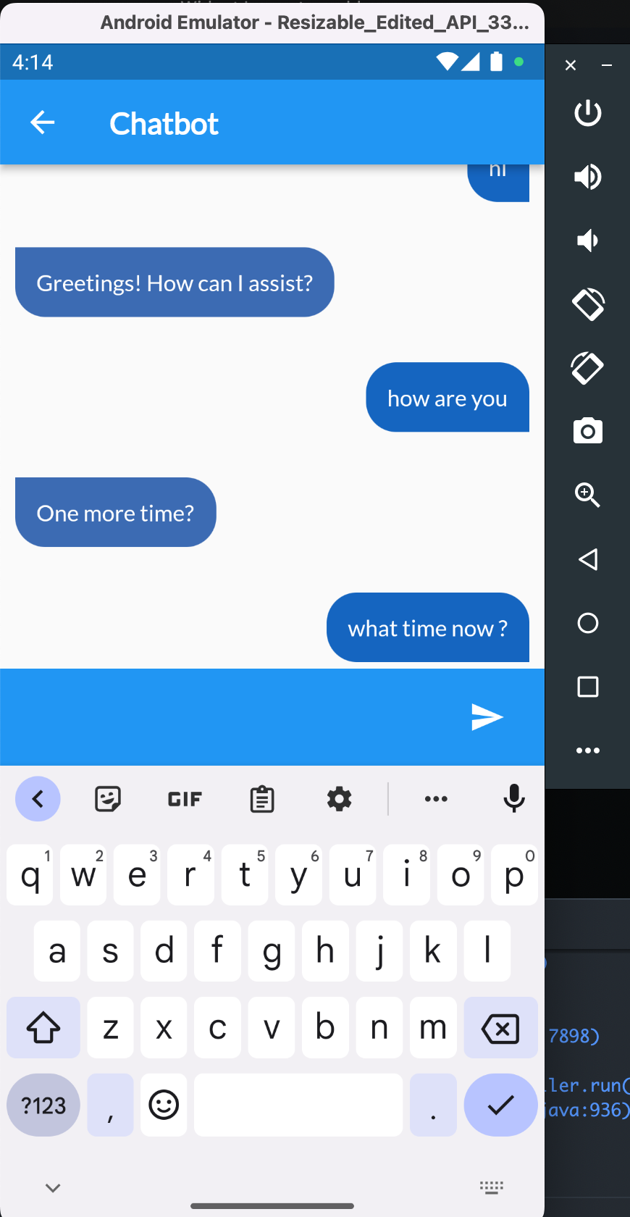
Output

Slide 11
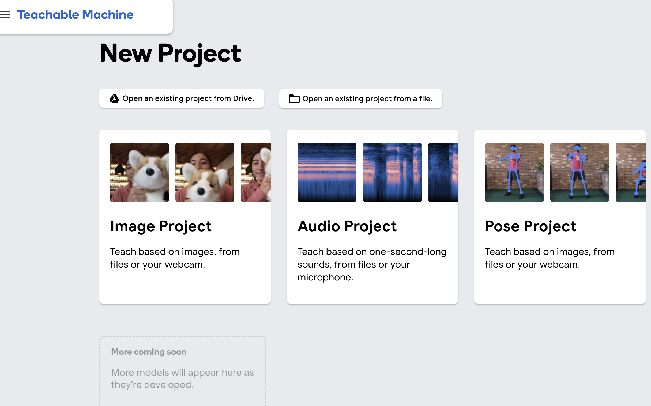
Teachable Machine

Slide 12
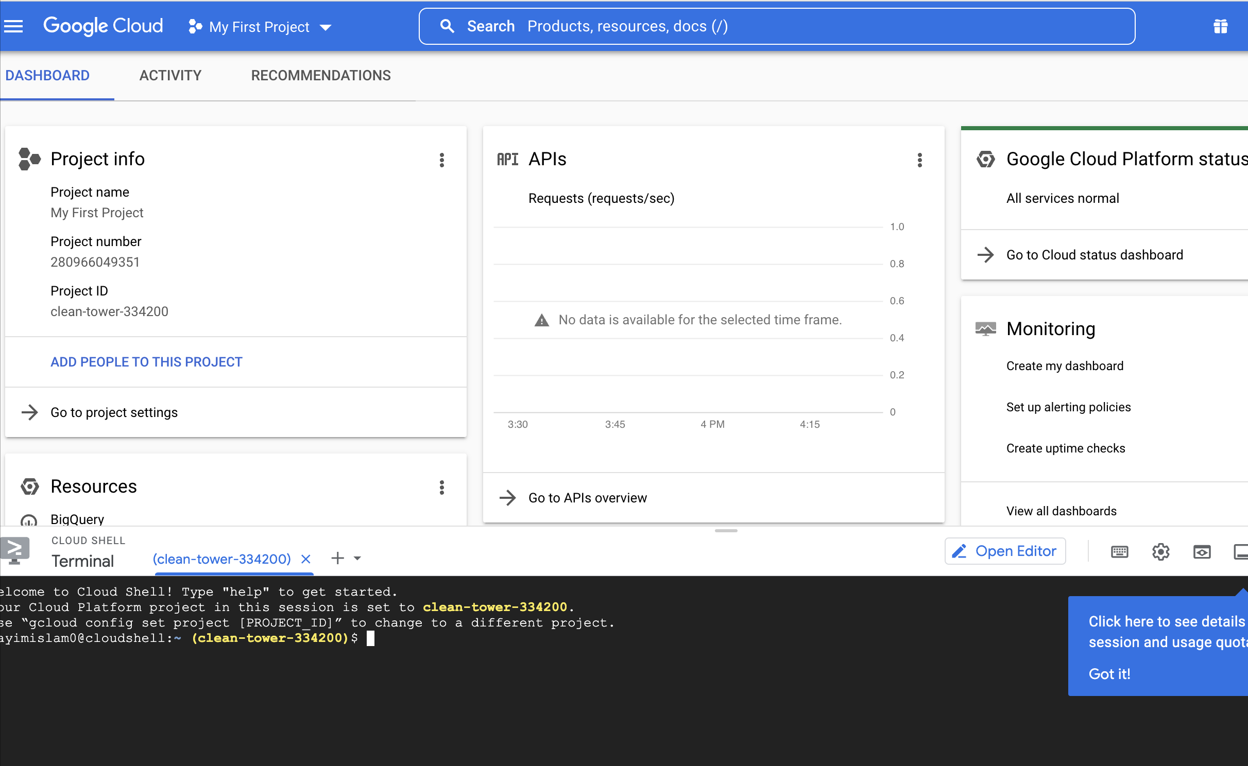
Google Cloud

Slide 13
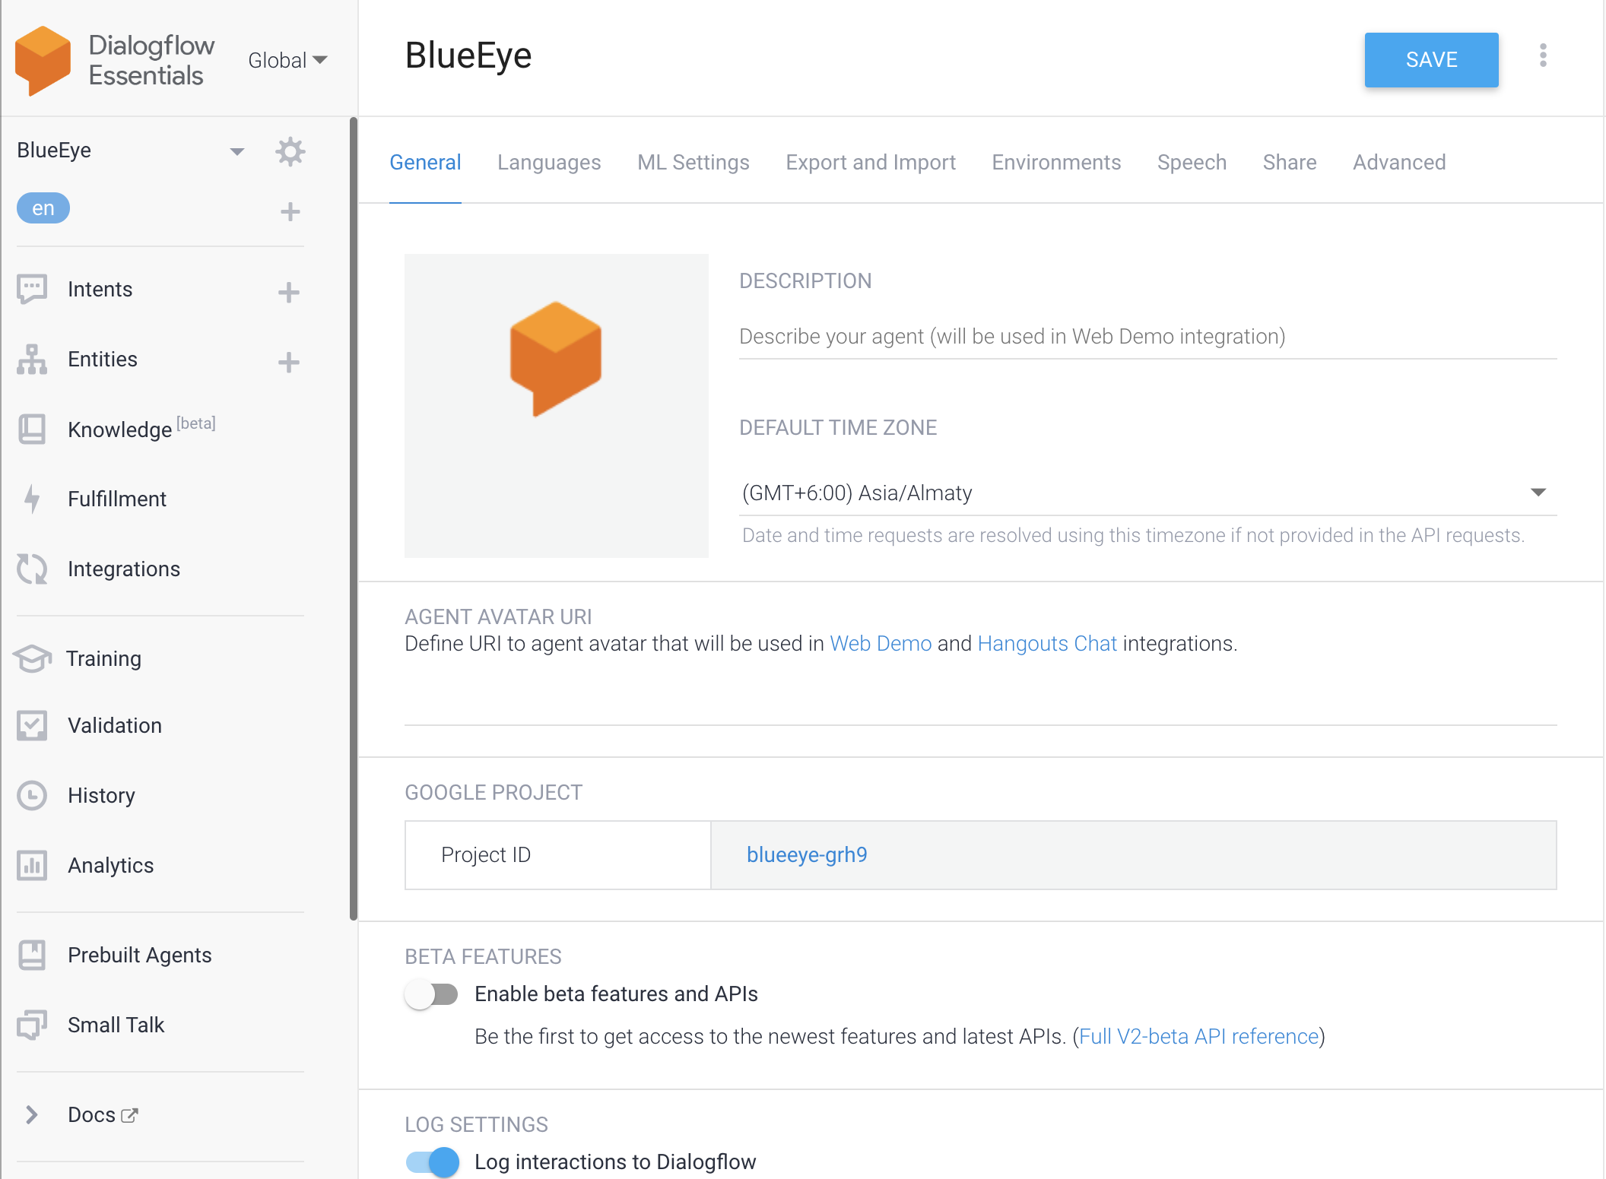
Dialog flow

Slide 14
Planning
Often there is a problem in detecting the same type of object and due to very low detection accuracy, it often shows wrong information. In the case of chatbots, people often get confused because they do not understand emotions. Note that if there is too much noise, the voice assistant will do the wrong thing. I will try to solve these problems as quickly as possible and reduce the percentage of mistakes. I will give the customer a nice user interface next update.

Slide 15
Conclusion
Often there is a problem in detecting the same type of object and due to very low detection accuracy, it often shows wrong information. In the case of chatbots, people often get confused because they do not understand emotions. Note that if there is too much noise, the voice assistant will do the wrong thing. I will try to solve these problems as quickly as possible and reduce the percentage of mistakes. I will give the customer a nice user interface next update.

Slide 16
Application Link
Project Link: https://github.com/MdNayimIslam/blue_eye
APK Link: https://drive.google.com/file/d/1sMuJJIIk5HmMwOVjnFWfgm0I-JfBw8ud/view?usp=sharing

